Slide 1
Telemetry is just a fancy word for “usage data”
Data
Insights
Actions

Slide 2
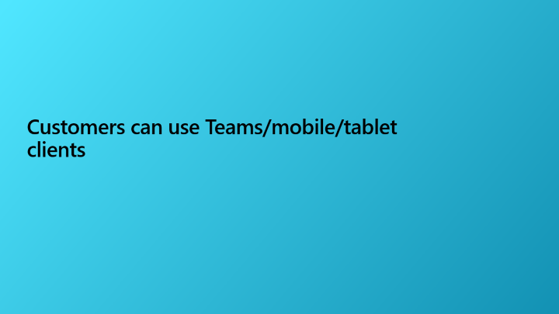
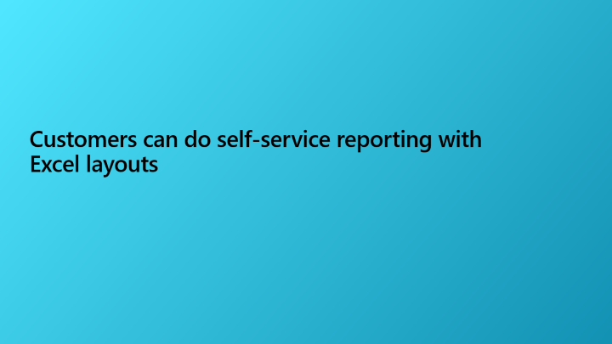
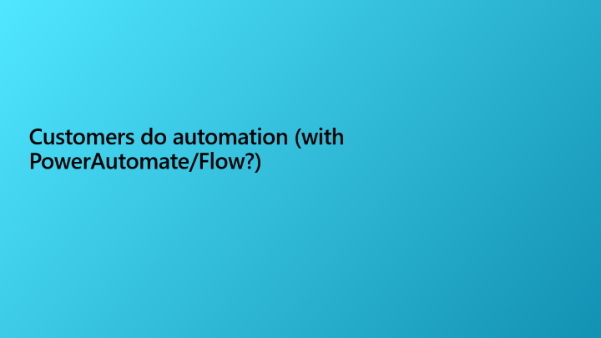


Topics to consider for your follow-up meeting

Slide 3
Health check

Slide 4
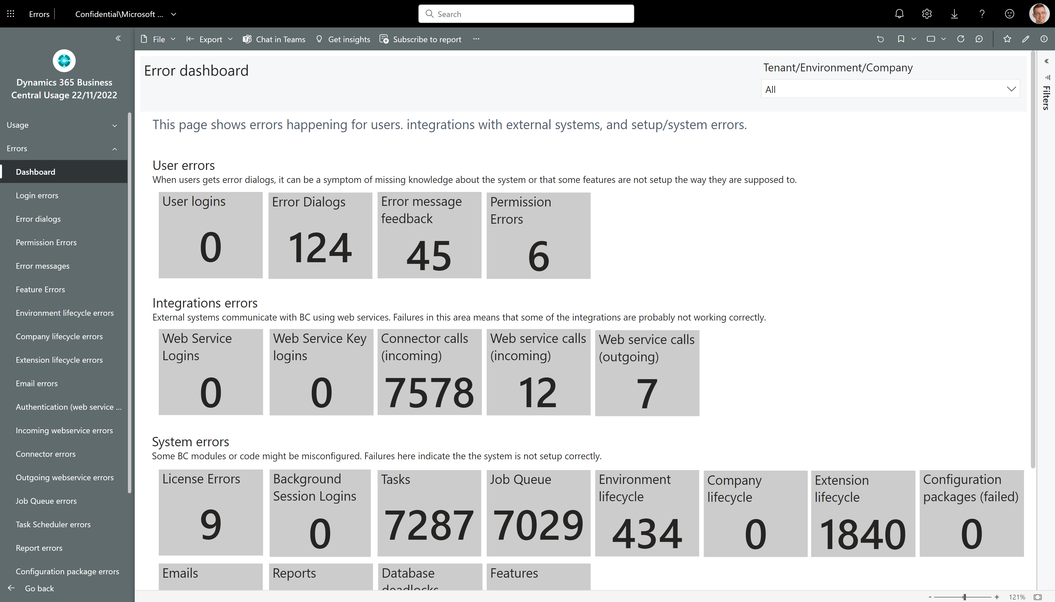
Is the customer struggling with errors?
Notes:
Filter away Areas with Empty, Bland, Administration, or Other

Slide 5
Depending on the errors shown…
Maybe check with consultants if there are things that need to be looked at now.
Better to know this up front before the meeting so that you can confidently say
“Before we start the meeting, I just want to say that we are aware of the issues with XYZ and are already looking into this.”

Slide 6
Out of the box features

Slide 7
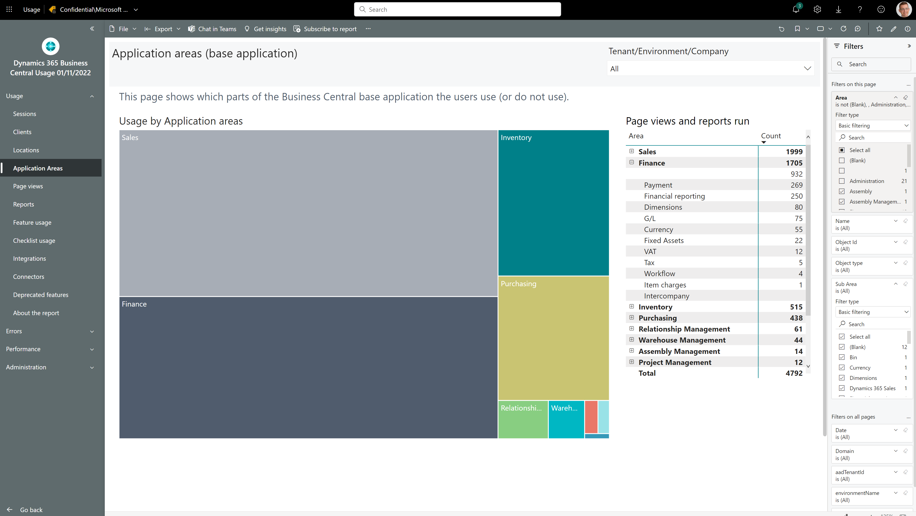
How to see which standard features customers use
Notes:
Filter away Areas with Empty, Bland, Administration, or Other

Slide 8
Depending on the customers business…
Maybe there are application areas that fit their business and that they already pay for, e.g. fixed assets.

Slide 9
Customers can do self-service reporting with Excel layouts

Slide 10
Excel layouts in five bullets
Interactive reports (Not designed for print, One report can serve multiple purposes (filtering, sorting, slicers, pivot tables etc.)
Mix’n’match data from Business Central with other data sources (Sharepoint lists, On-premises databases, files, APIs, …) using Power Query in the report.
Use built-in, advanced Excel features to do post-processing on rendered reports (triggering automation flows, Organization data types, What-if analyses, Forecast sheet, Analyze Data with support for natural language)
Rich collaboration capabilities (commenting, sharing, protecting for certain audiences) on a report
Democratized design experience - allowing end users to participate more actively in layout creation. Contains the raw data, making it possible for a user to understand how the report works

Slide 11
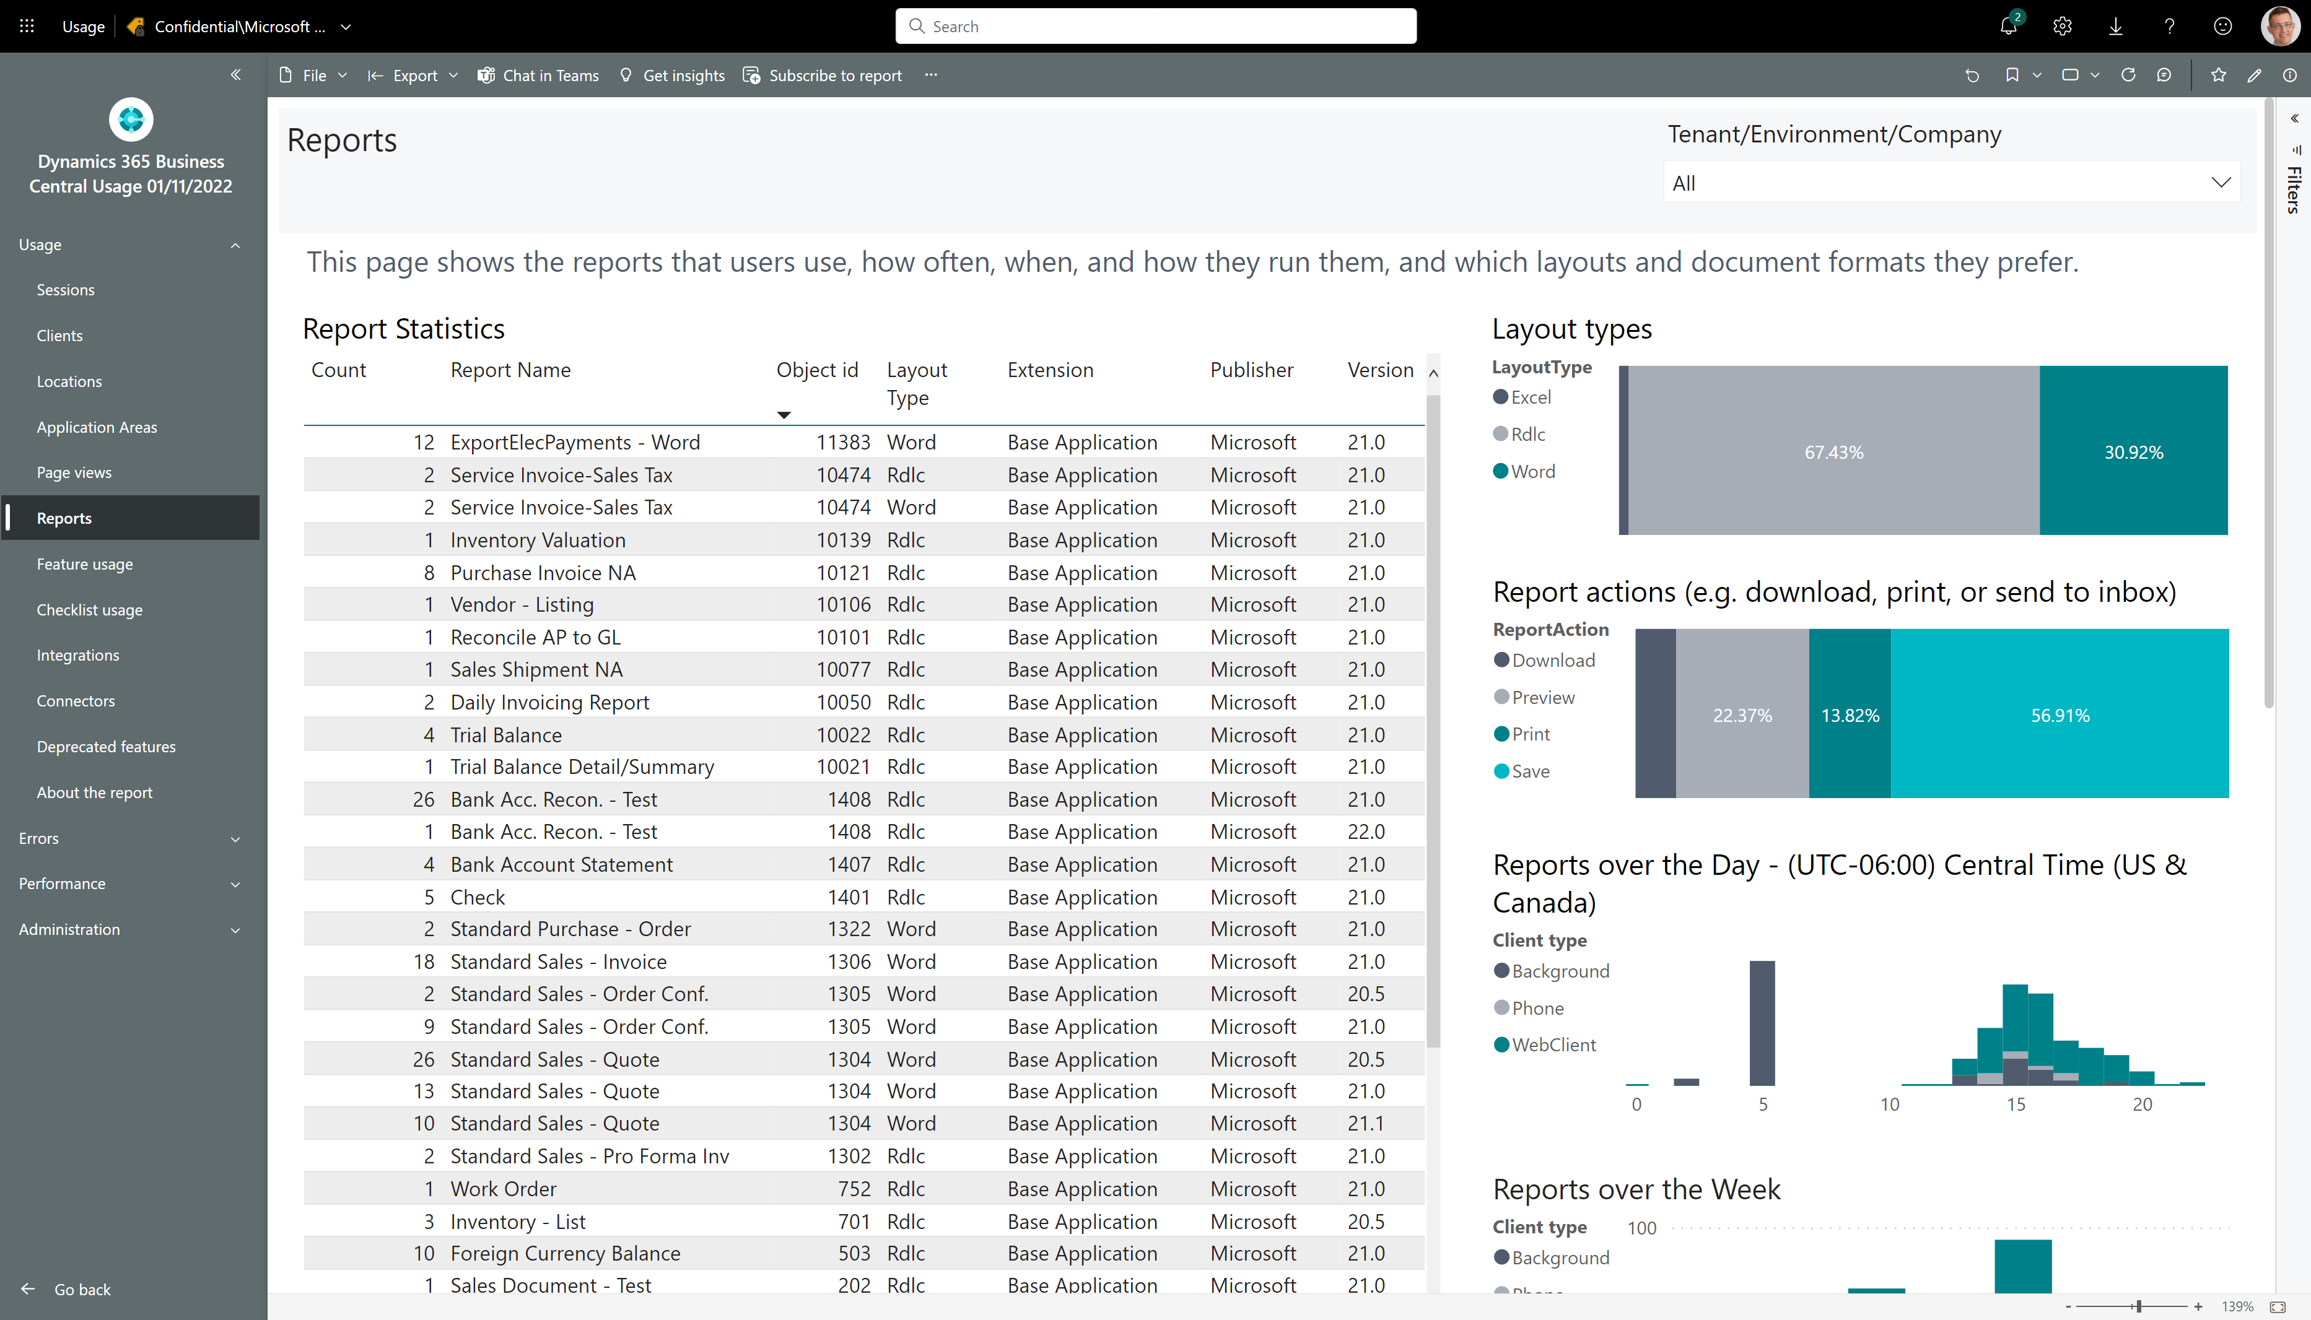
How to see if customer is using Excel layouts

Slide 12
End users can make report layouts with Excel
Excel layouts usage?
No Excel layouts usage?
Maybe collaborate closer on reporting?
You as partner can focus on AL report objects and customer can focus on layout
Introduce Power Query in Excel
Maybe PoC reports that mix data from Business Central with other data sources (Using Power Query)
Showcase sample layouts from https://aka.ms/bcexcelsamples
Maybe do a presentation on Excel layouts. Sample presentation is available from https://aka.ms/bcexcelsamples

Slide 13
Excel layouts resources
Samples
https://aka.ms/bcexcelsamples
Documentation
Working with Excel Layouts - Business Central | Microsoft Learn
Videos
https://github.com/microsoft/BCTech/blob/master/samples/Excel/VIDEOS.md

Slide 14
Customers do automation (with PowerAutomate/Flow?)

Slide 15
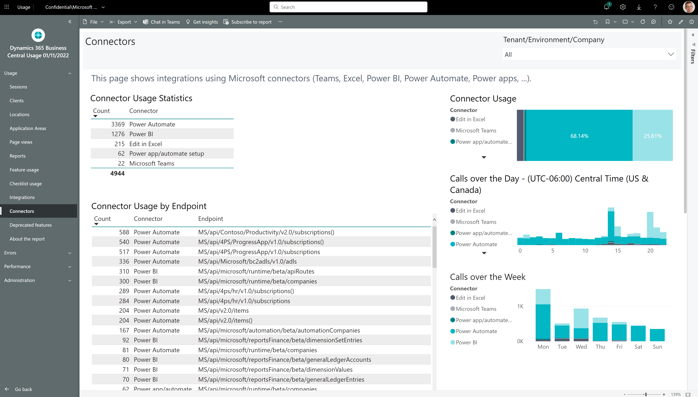
How to see if customer is using Microsoft connectors

Slide 16
Customers can automate processes with Power Automate
Power Automate usage?
No Power Automate usage?
Maybe collaborate closer on automation?
Use your experience from similar customers to suggest new ways to automate processes.
You as partner work on AL parts, customer owns the Power Automate artifacts
Help with engineering practices on Power Automate artifacts (source control, test/prod versions)
Showcase a simple flow
Maybe do a presentation on Power Automate

Slide 17
Power Automate resources
Samples
TODO
Documentation
https://aka.ms/bcautomate
Training
Use Power Automate with Business Central - Training | Microsoft Learn
Videos
https://www.bing.com/videos/search?q=%22business+central%22+power+automate

Slide 18
Customers can use Teams/mobile/tablet clients

Slide 19
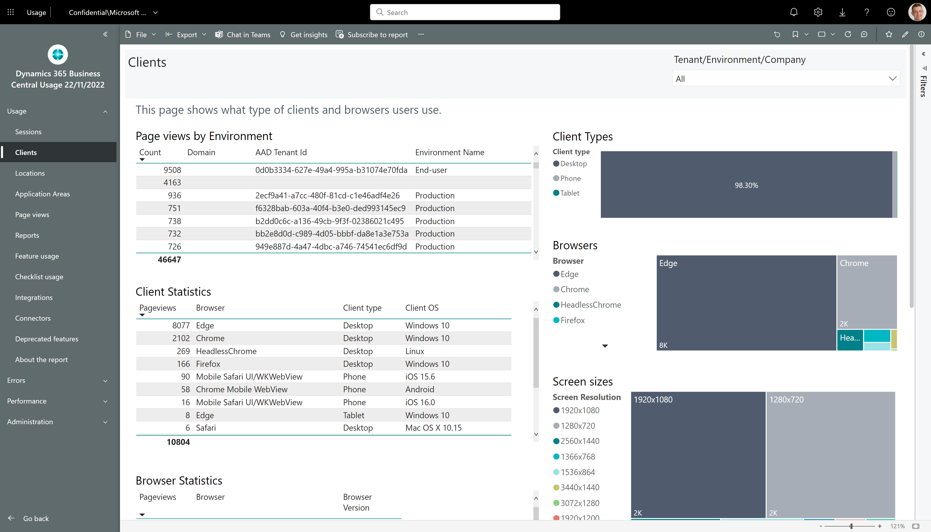
How to see which clients the users at customer use

Slide 20
Customers can collaborate with Teams
Teams usage?
No Teams usage?
Maybe collaborate closer on collaboration scenarios?
Use your experience from similar customers to suggest new ways to collaborate using Teams.
Is the customer involving non-Business Central users yet? If not, show how this is possible (see scenario catalogue below).
Showcase a simple collaboration flow
Show how non-Business Central users can join the conversation

Slide 21
Teams scenario catalogue
Unlock master data for all employees across the organisation
Empower departments that don’t run on Business Central to self-serve, by accessing key data needed to successfully perform their tasks
Increase collaboration efficacy so that tasks and projects that span across departments complete on time
Increase team performance so that people can make data-driven decisions that are inclusive of everyone
Meet licensing budget targets, by assigning licences that progressively match employee needs
Improve data security by reducing the need for pasting screen snippets of business data outside of data governance boundaries.

Slide 22
Teams with Business Central resources
Documentation (including usage scenarios)
https://learn.microsoft.com/en-gb/dynamics365/business-central/admin-access-with-m365-license#why-enable-access-with-microsoft-365-licenses

Slide 23
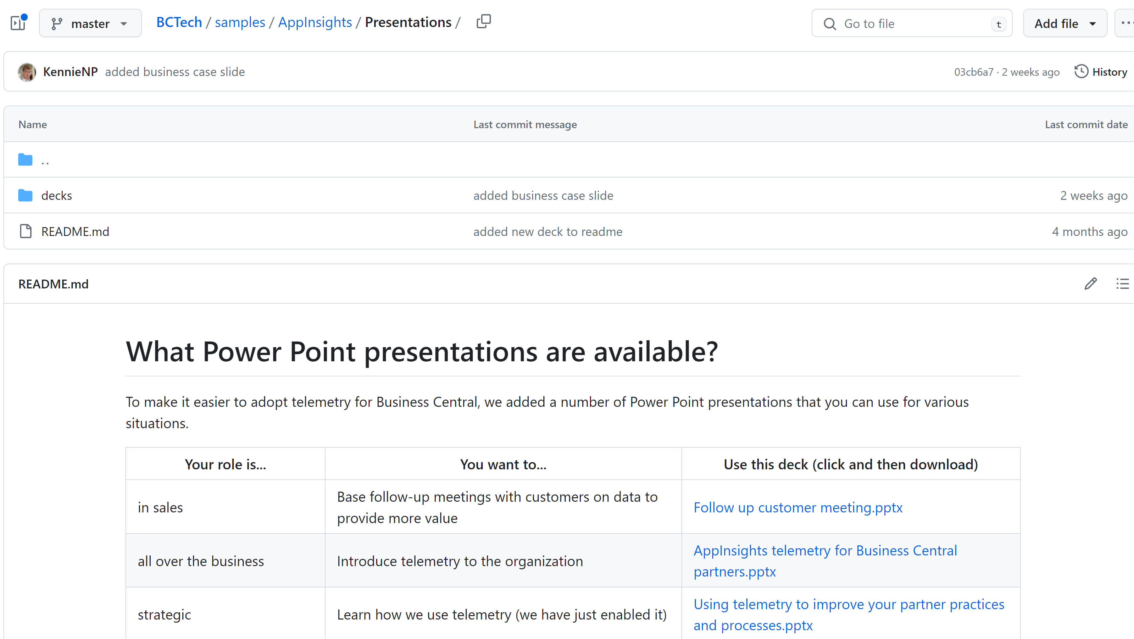
aka.ms/bctelemetrysamples

Slide 24
aka.ms/bctelemetry

Slide 25
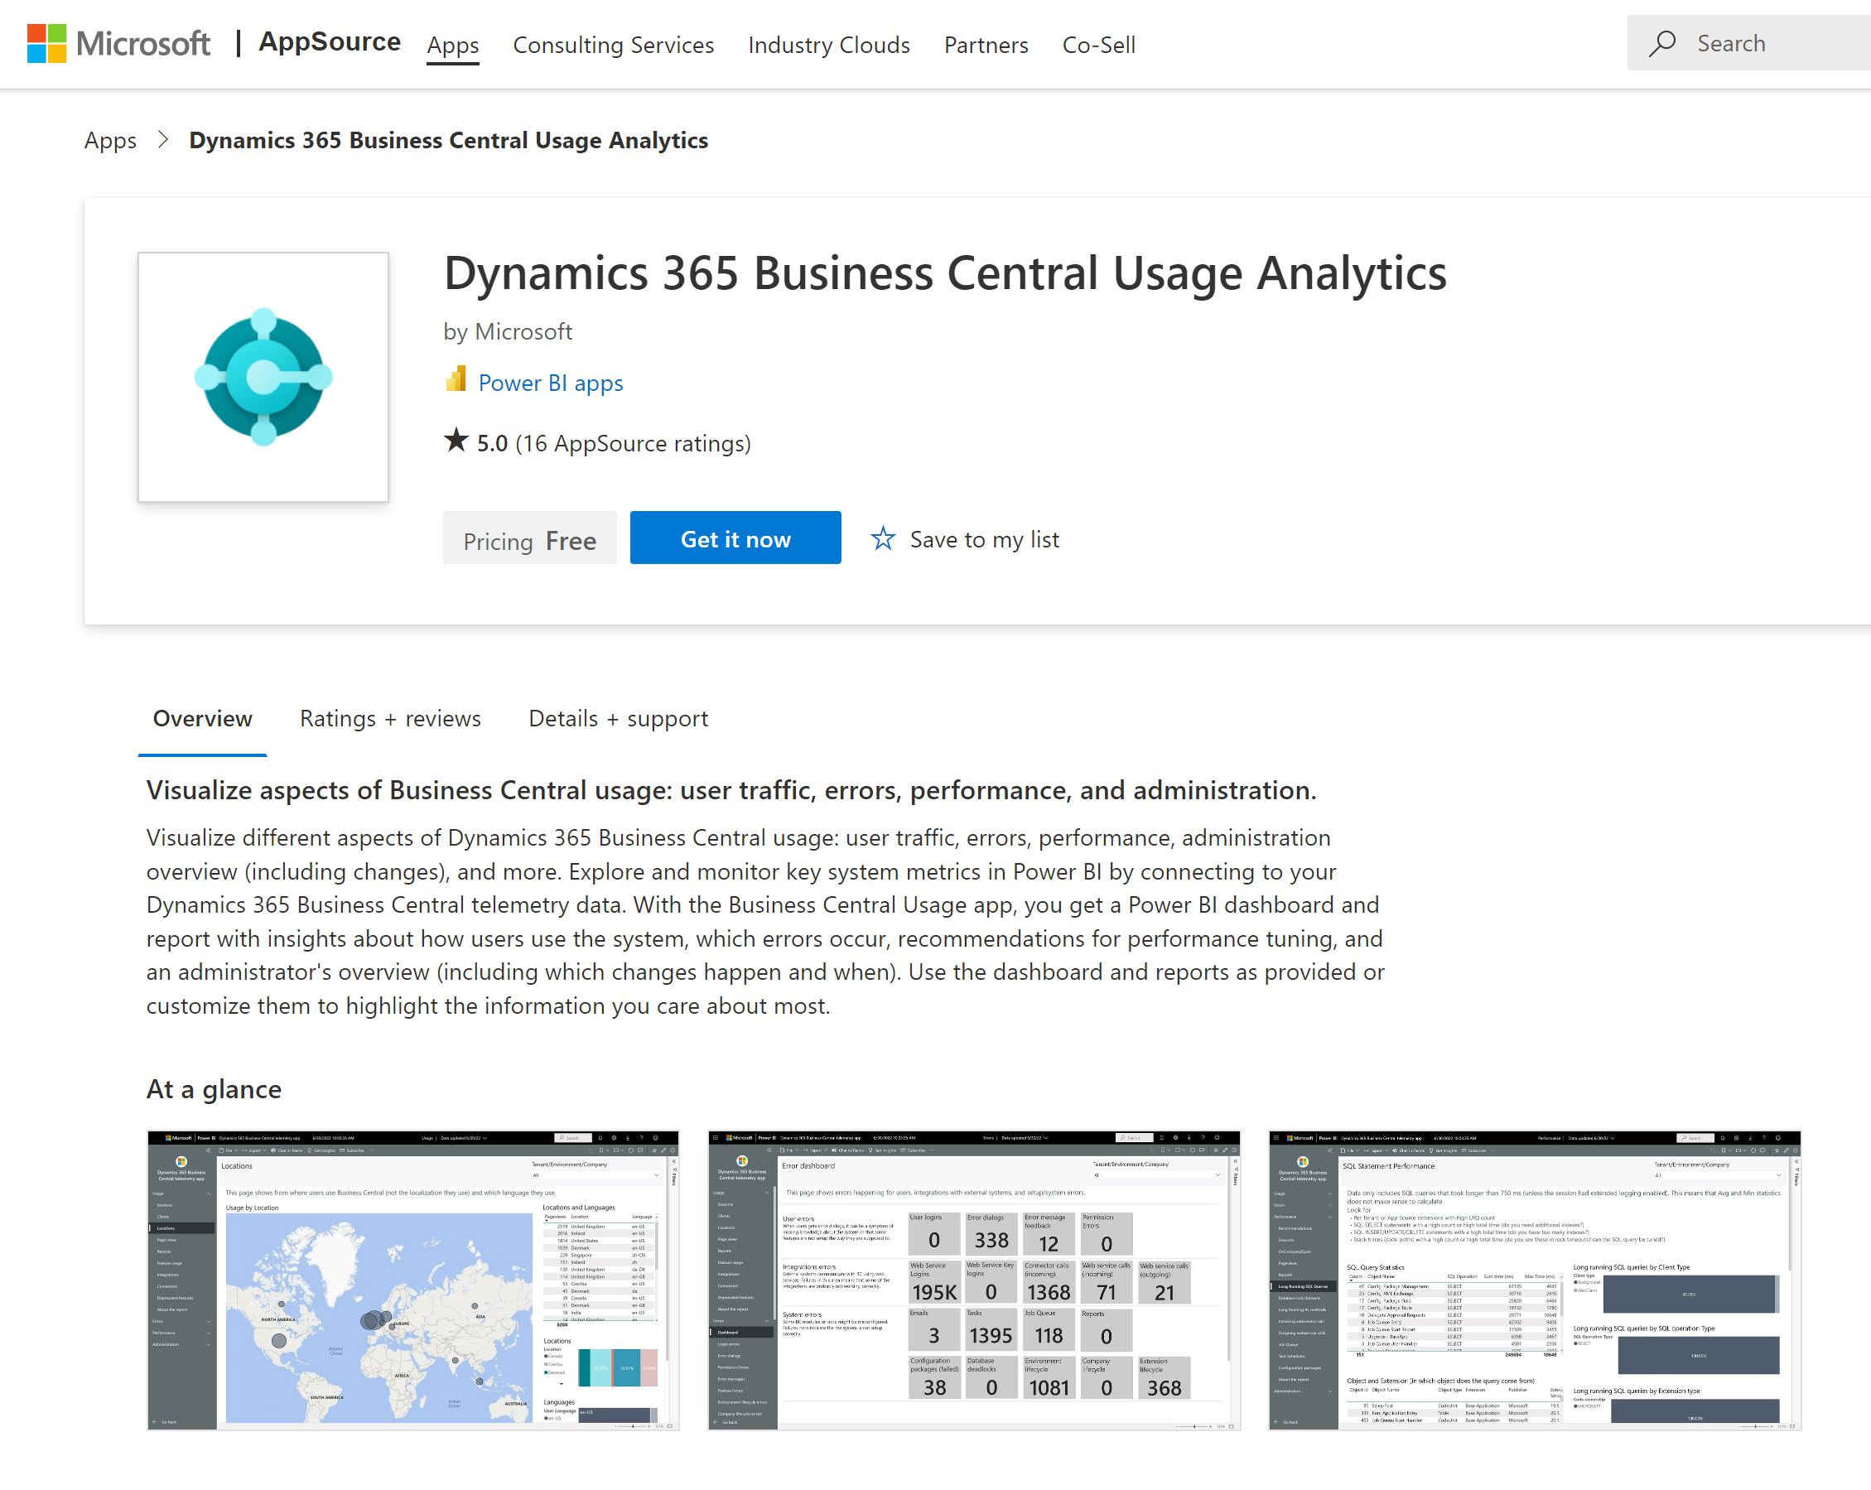
Get the app from aka.ms/bctelemetryreport

Slide 26
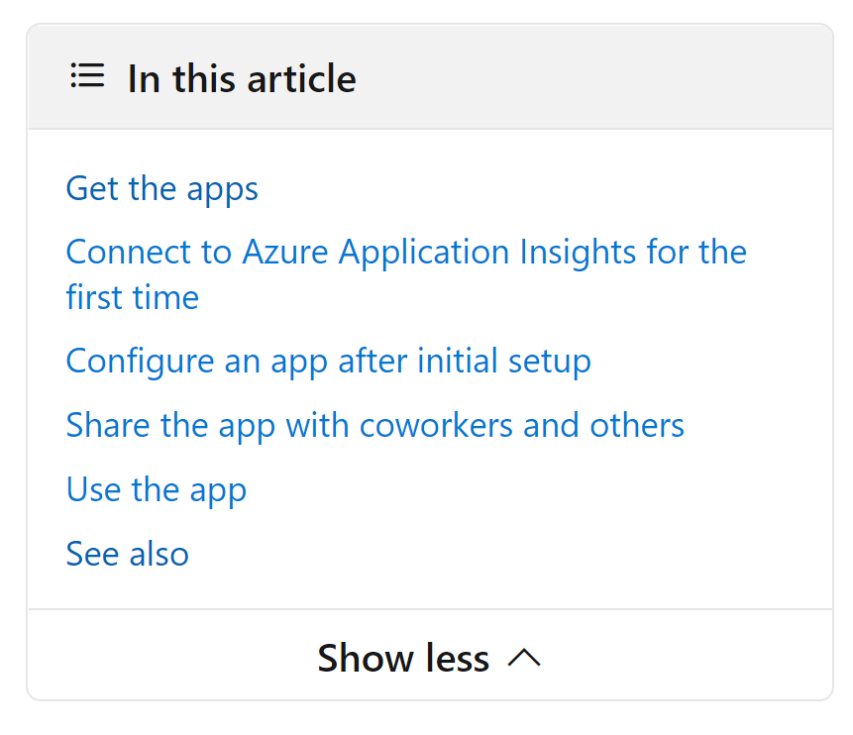
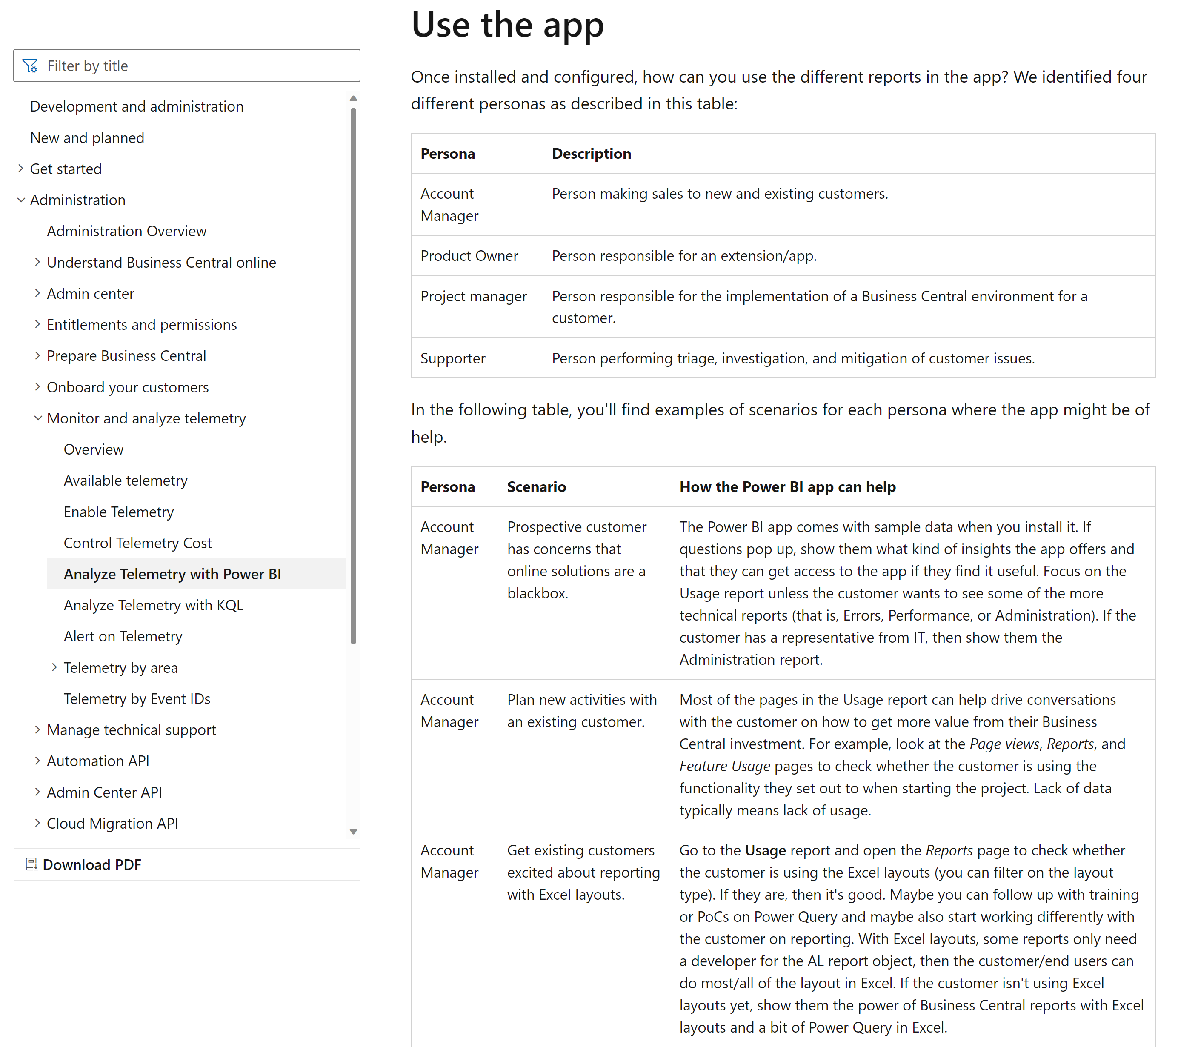
App usage documented on aka.ms/bctelemetry

